Slide 1
Internal Circuit of Op-Amp

Slide 2
Op-Amp Internal Circuit
An op-amp is a multistage, direct-coupled, high-gain amplifier that uses negative feedback, consists of one or more differential amplifier stages, and ends with a level translator and an output stage.
The input (differential) stage, often implemented using two cascaded differential amplifiers, provides high input resistance and the initial voltage gain of the op-amp.
Differential amplifier is a basic building block of an op-amp. The function of a differential amplifier is to amplify the difference between two input signals. The two transistors Q1 and Q2 have identical characteristics.
The resistances of the circuits are equal, i.e. RE1 = R E2, RC1 = R C2 and the magnitude of +VCC is equal to the magnitude of -VEE. These voltages are measured with respect to ground.

Slide 3
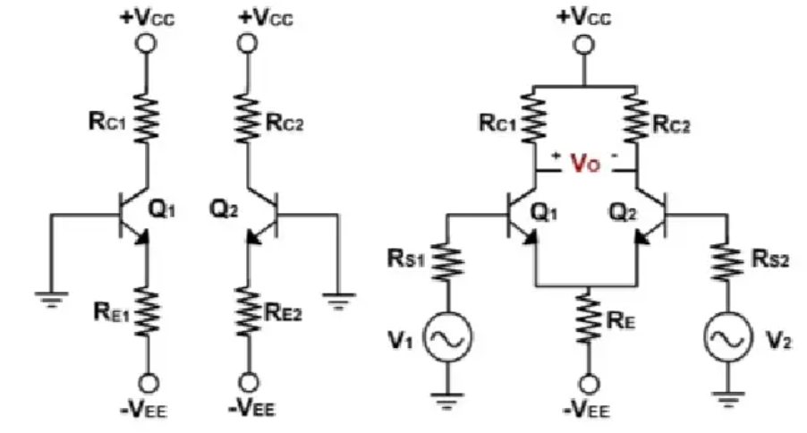

Slide 4
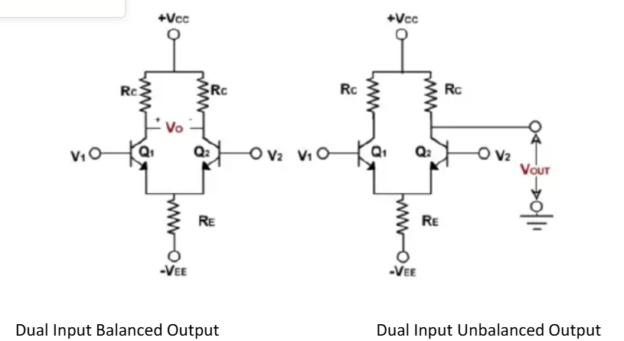

Slide 5
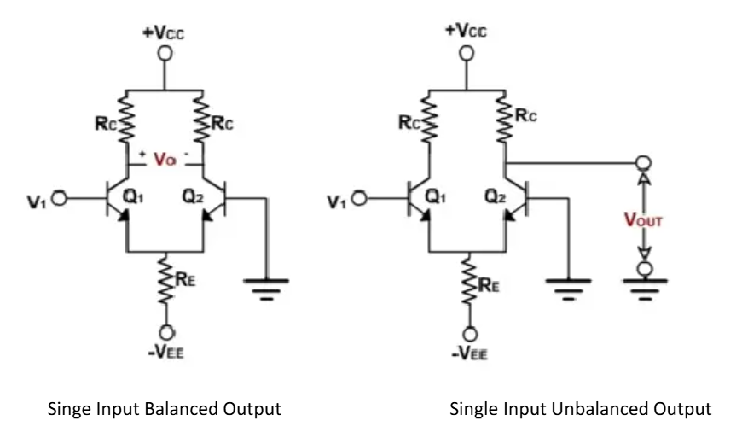

Slide 6
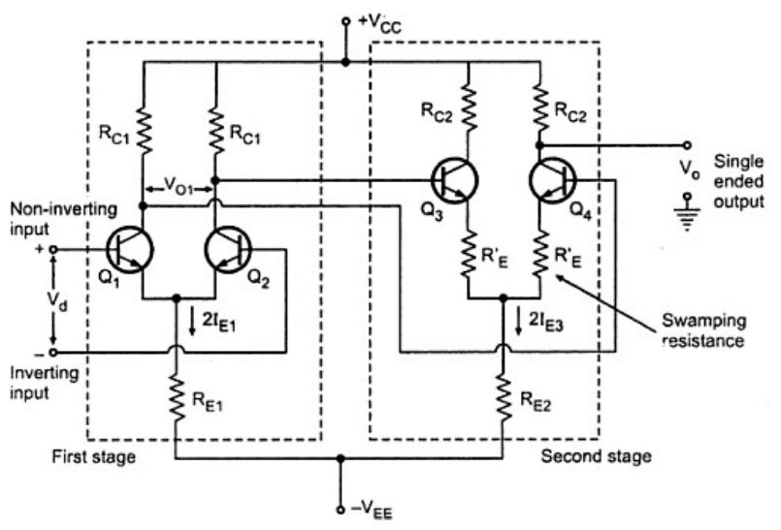
Cascaded differential stage

Slide 7
Level Shifter
Direct coupling between successive differential stages causes a progressive rise in DC bias voltage levels, shifting operating points, limiting output swing, and risking signal distortion.
To restore the DC output level to zero or a desired reference voltage, level translator circuits—typically emitter followers with resistive dividers—are inserted between stages.
Simple voltage-divider emitter followers can be enhanced with diode-based or current-mirror biasing for better thermal stability, lower output impedance, and more precise DC level shifting.

Slide 8
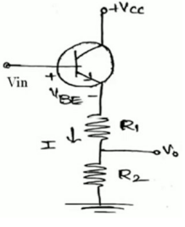
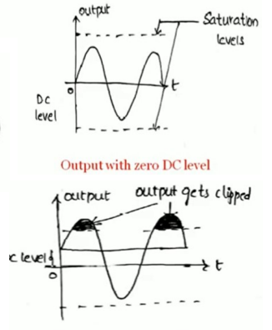
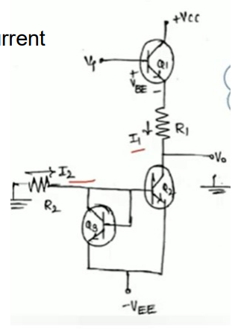
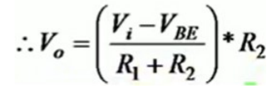

Here LS act like a buffer to isolate high gain stages from output. The amount of shift obtained is

Slide 9
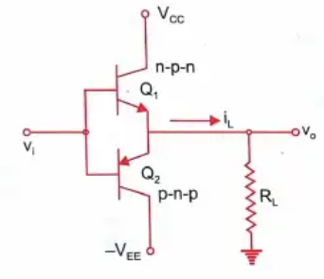
Output stage
The final stage is usually a push pull complementary symmetry amplifier output stage. The output stage increases the voltage swing and raises the ground supplying capabilities of the op-amp. A well designed output stage also provides low output resistance.
If Vi is positive , Q1 is ON and supplies current to load RL. If Vi is negative, Q1 is Cutoff, Q2 acts as sink to remove current from load RL.The limitation of this circuit is the output voltage Vo remains zero until Vi exceeds Vbe(cut-in). This is called cross over distortion

Slide 10
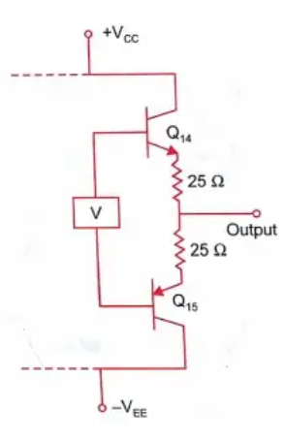
The problem with above circuit can be eliminated by applying bias voltage V slightly greater than 2Vbe = 1 V between two bases, so that small current flows in transistors even in Quiescent state. The figure shows the output stage of uA741 op-amp. V represents VBE Multiplier and 25 ohm resistor to stabilize Quiescent base current.

Slide 11
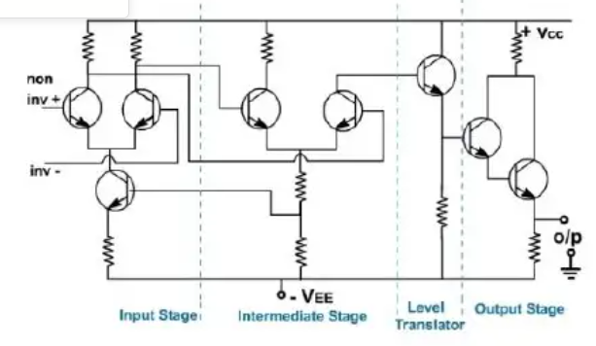

Slide 12
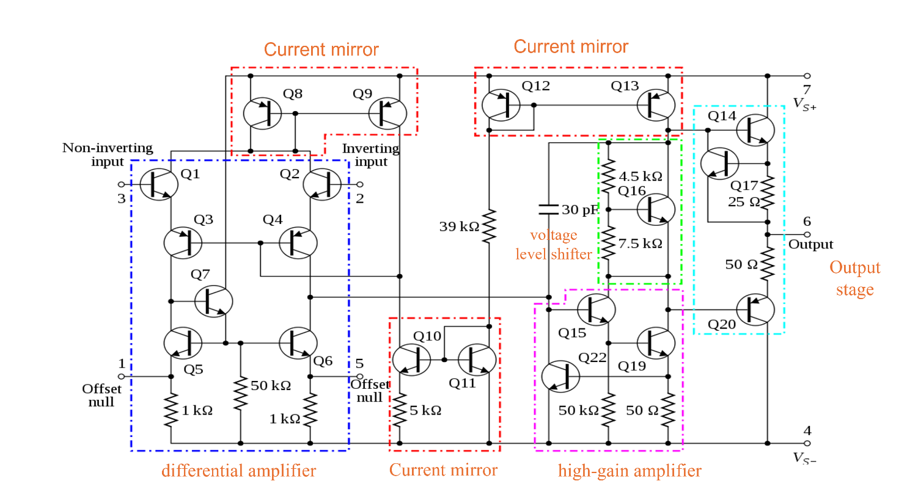

Slide 13
Thank You!

